Slide 1
Case study - Open water shellfish farming Application of the FARM model
Manila clam in a commercial farm in North Puget Sound, USA;
Fieldwork (data acquisition for water quality, clam growth measurements, etc);
Development, calibration, and validation of an individual growth model for Manila clam (Tapes philippinarum);
Integration into the FARM (Farm Aquaculture Resource Management) model, calibration and validation of the population model;
Seaweed fouling was incorporated in FARM, to simulate potential effects on yield;
Standard model to simulate cultivation cycle, profit and loss, and environmental effects.
Saurel et al., 2014. Aquaculture-Environment Interactions, 5, 255-270.
Notes:
**** Intro to AquaShell from last SK progress report -- Individual clam growth model for Manila clam, Tapes philippinarum, following the generic framework defined in the AquaShell model. The individual model uses a net energy balance approach and will draw on functions published in the literature, representing key physiological processes, together with new formulations.

Slide 2
Down on the farm
Manila clam harvesting in North Puget Sound

Slide 3
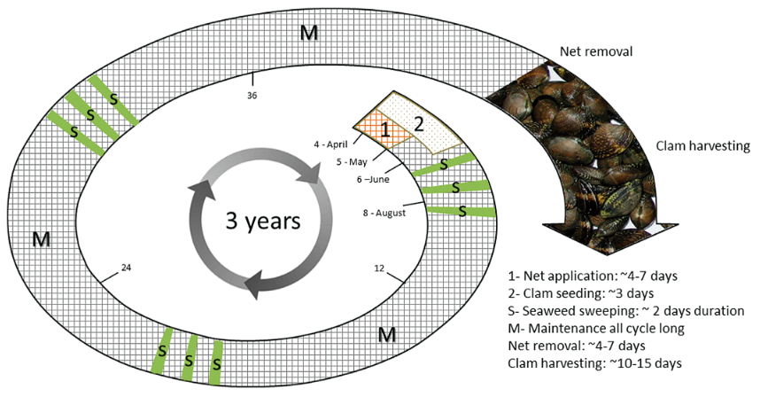
Culture practice in Puget Sound Manila clams in bottom culture
Cultivation in three cohorts for annual harvest.

Slide 4
Simulation of clam shell length with Samish Island environmental drivers
55
No growth in winter
50
45
40
Shell length (mm)
35
Aquashell model
30
2009 plant - preharvest June
2010 seed
25
2011 seed
20
0
200
400
600
800
1000
1200
1400
Julian Day
The individual model provides a good fit to project data for shell length.

Slide 5
Simulation of clam live weight with Samish Island environmental drivers
Negative scope for growth in winter
30
25
20
Live weight (g)
15
10
Aquashell model
2009 plant - preharvest June
5
2010 seed
2011 seed
0
0
200
400
600
800
1000
1200
1400
Julian Day
The AquaShell model also shows a good fit to project data for live weight…

Slide 6
Simulation of tissue dry weight with Samish Island environmental drivers
2.5
preharvest June
Aquashell model
2009 plant - preharvest June
2
2010 seed
-
2011 seed
1.5
Tissue fry weight (g)
1
0.5
0
0
200
400
600
800
1000
1200
1400
Julian Day
And for tissue dry weight. So we’re okay to move to the farm scale. But first…

Slide 7
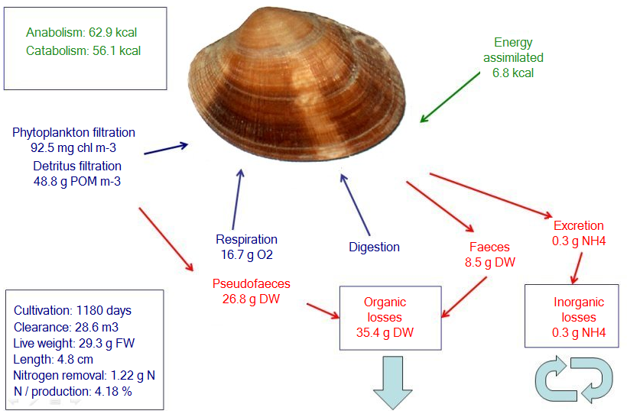
Manila clam growth model (AquaShell) Mass balance
Simulation of Manila clam growth using Samish Island drivers provides outputs on production and environmental effects. These are then scaled to the culture area.
Notes:
AquaShell conversion 20300 J g-1 DW Energy asssimilated 6.7 kcal 6700 cal Conversion: 1 cal 4.184 Energy assimilated 28032.8 J Equivalent tissue DW 1.380926 g DTW

Slide 8
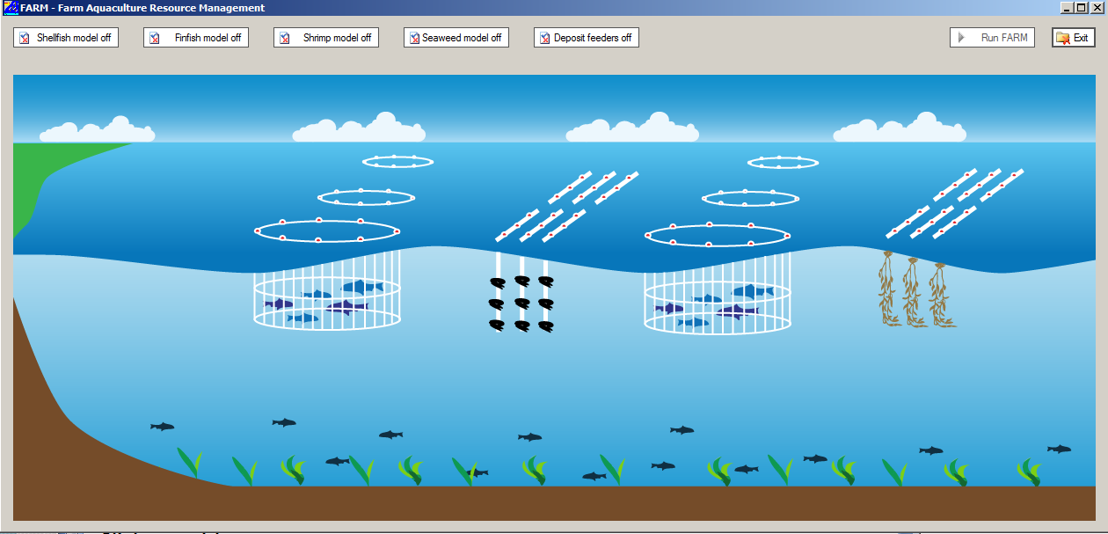
FARM model Application to Integrated Multi-Trophic Aquaculture (IMTA)
FARM model for finfish, shellfish, seaweed, and deposit feeders.
Ferreira et al., 2012. Cultivation of gilthead bream in monoculture and integrated multi-trophic aquaculture. Analysis of production and environmental effects by means of the FARM model. Aquaculture 358-359, p. 23-34.

Slide 9
Production and environmental effects of Manila clam farming in North Puget Sound (per 1180 day cycle)
Variable | Model results
Model inputs
Seeding (kg TFW) per production cycle | 3,400
Model outputs
Production
Total (TPP) (kg TFW) per production cycle | 157,600
Average Physical Product (APP, Output/Input) | 47
Environmental externalities
Change in percentile 90 NH₄⁺ concentration (μmol L-1) | 8.92 (in) – 9.04 (out)
Change in percentile 90 chlorophyll (mg chl m⁻³) | 4.49 (in) – 3.98 (out)
Change in percentile 10 O₂ concentration (mg L-1) | 6.17 (in) – 6.10 (out)
ASSETS eutrophication model score | 5 - No change (in to out)
Profit and loss
Manila clam sales ($ per cycle) | 630,000
Total income ($ per cycle) | 630,000
Seed ($ per cycle) | 135,000
Total marginal expenditure ($ per cycle) | 135,000
Income-Expenditure ($ per cycle) | 495,000
Farm profit ($ per cycle) | 495,000
Reported annual harvest is 70,000 – 100,000 lb. Annualized output from FARM is 107,217 lb, considering 18 g live weight (TFW) as a minimum weight for harvest
Annualized gross profit determined with FARM is about 153,000 dollars.
Notes:
Seeding changed (first class is 0-0.4 g). Therefore your18 million seed = 18 X 0.2 = 3.6 tons
At $40 / kg = $40,000 X 3.6 = $144,000.
Because of greater yield thru model recalibration re: spawning, profits are now about 207k/y.
Seeding at 8,400 results in 42 million seed. For the full farm at 22,500 sq m @ 806 seed / sq m a total of ~18 million seed would be needed. If it is assumed 1/3rd of farm is seeded each year or area of 7,500 sq m then @ 806 seed per m, a total of ~6 million seed would be needed. Thus the seed cost would range from $48,000 (1/3 of farm seeded per year) to $144,000 (the entire farm seeded each year).

Slide 10
Seaweed fouling and sweeping simulation FARM model – Samish Island Manila clam farm
Sweeping in mid-year
50
Twenty onsite measurements of seaweed dry weight: 90th percentile = 47.4 g DW
45
40
35
30
25
Seaweed fouling (g DW m⁻²)
Year 1
Year 2
Year 3
20
15
10
5
0
200
400
600
800
1000
1200
1400
Julian Day
As the Manila clams grow bigger, more NH₄⁺ is excreted, stimulating seaweed fouling; this is why the biomass peaks increase from year to year.
Notes:
Initial seaweed weight = 5 g DW; culture start: day 200; period: 1180 days. Sweeping mulching, day 180 of each year.
Model tuned for reduced growth of seaweeds. Peaks observed by Andy: P90: 47.38 g DW (20 data points)
Seaweed fouling relevant to a single sweeping event, not continuous sweeping. Macroalgae product is similar to observations made at other locations, when very heavy macroalgae get mass mortalities of shellfish. Important to note that seaweed growth is partly in response to the ammonia the clams produce.

Slide 11
Change in seaweed fouling with and without clam excretion – FARM model results
4
Sweeping in mid-year
3.5
3
2.5
Δ seaweed fouling (Δ g DW m⁻²)
2
Year 1
Year 2
Year 3
1.5
1
0.5
0
200
400
600
800
1000
1200
1400
Julian Day
The difference in seaweed fouling with and without clams increases from year to year. Of course without predator nets, most likely there wouldn’t be any seaweeds.
Notes:
Initial seaweed weight = 5 g DW; culture start: day 200; period: 1180 days. Sweeping mulching, day 180 of each year.
Model tuned for reduced growth of seaweeds. Peaks observed by Andy: P90: 47.38 g DW (20 data points)
Seaweed fouling relevant to a single sweeping event, not continuous sweeping. Macroalgae product is similar to observations made at other locations, when very heavy macroalgae get mass mortalities of shellfish. Important to note that seaweed growth is partly in response to the ammonia the clams produce.

Slide 12
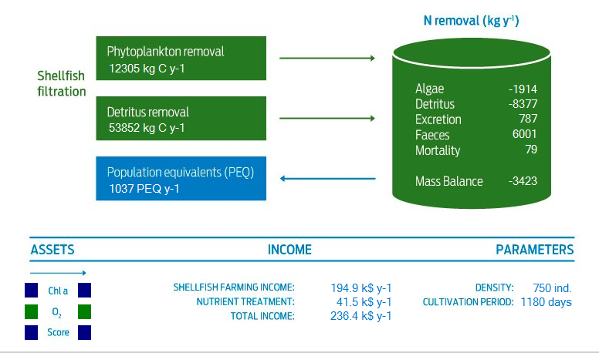
Samish Island Manila clam farm FARM model simulation for nutrient trading
At a cultivation density of 70 animals per sq ft. clams provide an annual ecosystem service equivalent to over 1000 people in reducing eutrophication.
Notes:
This is a mass balance model, annualized or per year 1180 day total growth cycle. Nutrient treatment based on Odd Lindahl values for treatment costs.

Slide 13
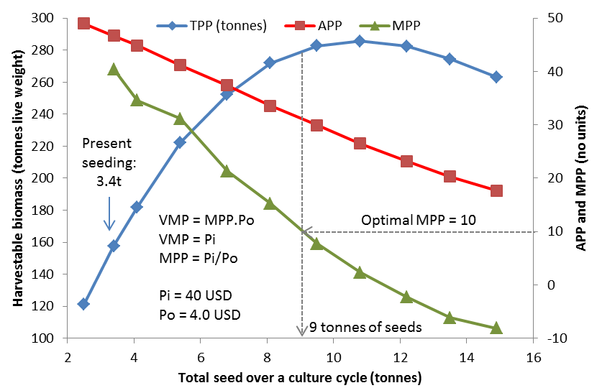
Marginal analysis FARM model – application to Samish Island Manila clam farm
The Samish Island farm appears to be well below carrying capacity, with respect to food supply. High mortality is observed, mainly due to predators.

Slide 14
Post-harvest feeding frenzy
The attack of the killer fish (video runs at 10X normal speed).
Notes:
Manila clams: about 5000 tonnes per year harvested in Puget Sound

Slide 15
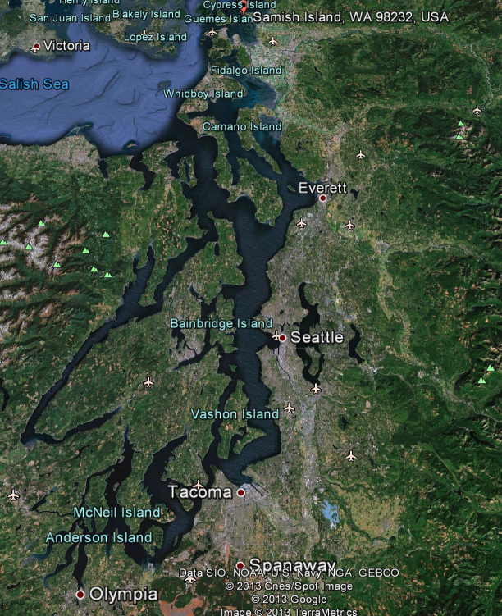
Scaling FARM results to Puget Sound Manila clam culture
Phytoplankton filtered
1007 ton C y⁻¹
Net nitrogen removal
280 ton N y⁻¹
Detritus filtered
4407 ton C y⁻¹
Population Equivalents
87818 people
Every year, clams provide Puget Sound with an ecosystem service equivalent to about 87,000 people, or 3.4 million dollars, in removing primary symptoms of eutrophication.
Notes:
Manila clams: about 5000 tonnes per year harvested in Puget Sound

